Slide 1
Marmotte Movie
Jakarta EE
Adrien Varone – Antoni Saez

Slide 2
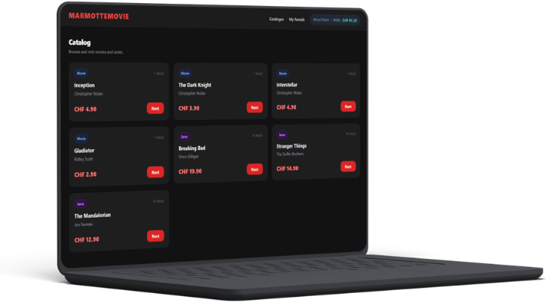
Marmotte Movie
Marmotte Movie offers a list of films and series that users can rent
You only pay for what you watch
No recurring subscription
Time-limited access each rental expires after a set number of days

Slide 3


Use case
Customer :
  Rent a media
  View active rentals
  Browse catalog
Manager :
  Inherits from the customer actions
  Add a movie
  Add a series

Slide 4
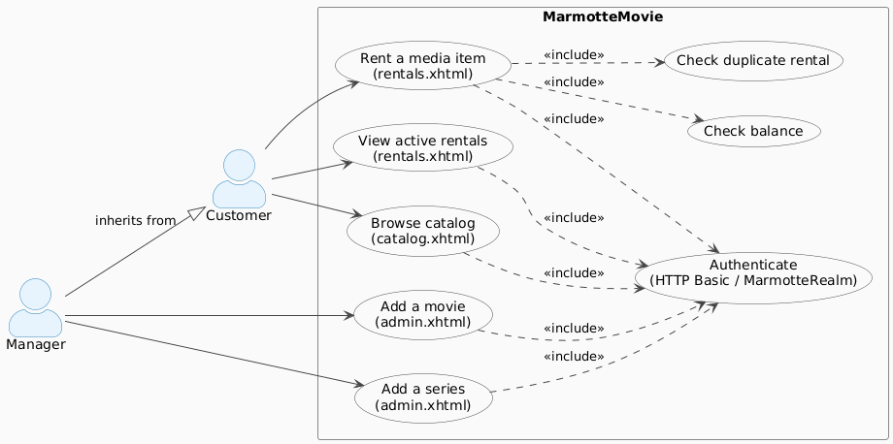
Use case

Slide 5
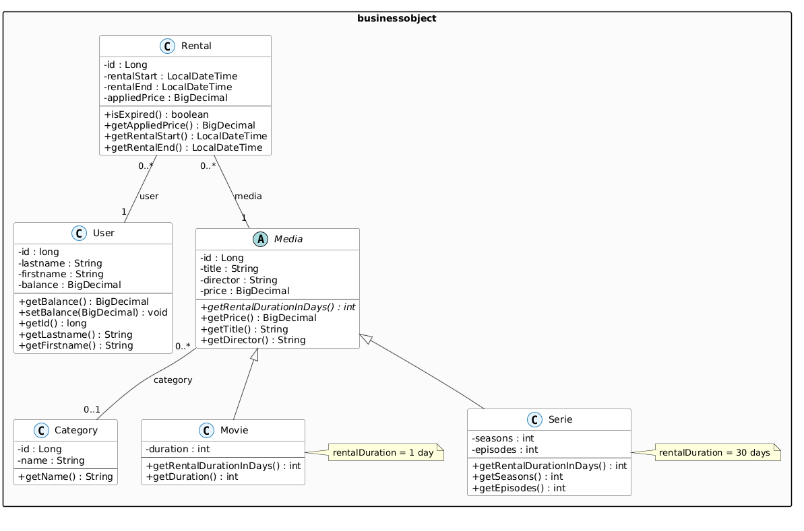
Three Tier
Entities

Slide 6
Three Tier
Business Layer
3 CDI Services :
MediaService (@ApplicationScoped) : manages the media catalogue and categories
RentalService (@RequestScoped) : core business logic for rentals
UserService (@RequestScoped) : resolves the authenticated user from the HTTP principal
RentalService enforces 3 rules atomically (@Transactional) :
User does not already have an active rental for the same media
User's balance is sufficient to cover the price
Balance is deducted and rental record is persisted — all in one transaction
Error handling via RentalException :
Typed Reason enum : ALREADY_RENTED, INSUFFICIENT_FUNDS, USER_NOT_FOUND, MEDIA_NOT_FOUND
Lets the presentation layer react without parsing error strings

Slide 7
Three Tier
Presentation Layer
3 JSF Managed Beans (@SessionScoped, @Named) :
RentalBean : handles the rental workflow for end users
AdminBean : allows admins to add new movies and series
RentalBean — key responsibilities :
Resolves the logged-in user from the HTTP security principal (via UserService)
Calls RentalService.rentMedia() and catches RentalException to display a user-friendly message
Exposes the list of active rentals for the current user
Exposes the entire catalog to the JSF view via getMedias() (via MediaService)
AdminBean — key responsibilities :
Creates a Movie or Serie depending on the selected type
Delegates persistence to MediaService, then resets the form on success

Slide 8
Technologie Overview
@Transactional : RentalService.rentMedia() : balance deduction + rental persist atomically in one transaction
@RequestScoped : RentalService / UserService are @RequestScoped
Inheritance : Media uses JOINED strategy with Movie and Serie as subclasses
Security : WildFly login module, security constraints in web.xml, principal resolved via HttpServletRequest.getUserPrincipal(), own form for the login.

Slide 9
Demo

